Slide 1

ADVANCED COMPUTER OPERATIONS (EXCEL 2016 ESSENTIALS COURSE)
Kayode Oladapo (phd)

Slide 2
Course Objectives
Ability to perform operations with formulas and functions
Summarize data by using functions
Perform conditional operations by using functions
Format and modify text by using functions
Ability to create charts and objects

Slide 3
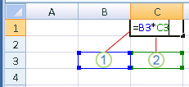
Summarize data by using functions
A. Insert References
In Microsoft Excel, cell referencing is the method by which you refer to a cell or series of cells in a formula. Cell referencing is not important unless you plan to copy the formula to a number of other cells. In Excel, cell referencing is relative by default.
Use cell references in a formula
Step 1: Click the cell in which you want to enter the formula.
Step 2: In the formula bar, type = (equal sign).
Step 3: select the cell that contains the value you want or type its cell reference.
Step 4: Press Enter
Note: 1. The first cell reference is B3, the color is blue,
and the cell range has a blue border with square corners.
2. The second cell reference is C3, the color is green, and
the cell range has a green border with square corners.

Slide 4
Summarize data by using functions
Now there are three kinds of cell references that you can use in Excel:
Relative Cell References: These cell references that adjust itself when the cell is copied are called relative cell references
Absolute Cell References: Unlike relative cell references, absolute cell references don’t change when you copy the formula to other cells. Absolute cell references are useful when you don’t want the cell reference to change as you copy formulas. This could be the case when you have a fixed value that you need to use in the formula (such as tax rate, commission rate, number of months, etc.)
Mixed Cell References: For locking both row and column
Note: Dollar Sign ($) is used to specify the type of referencing

Slide 5
Summarize data by using functions
B. Perform calculations by using the SUM function
SUM function
The SUM function adds values. You can add individual values, cell references or ranges or a mix of all three.
Syntax: SUM(number1,[number2],...)
For example:
=SUM(A2:A10) Adds the values in cells A2:10.
=SUM(A2:A10, C2:C10) Adds the values in cells A2:10, as well as cells C2:C10.

Slide 6
Summarize data by using functions
C. Perform calculations by using MIN and MAX functions
MAX function: Returns the largest value in a set of values.
Syntax: MAX(number1, [number2], ...)
The MAX function syntax has the following arguments:
Number1, number2, ... Number1 is required, subsequent numbers are optional. 1 to 255 numbers for which you want to find the maximum value.
MIN function: Returns the smallest number in a set of values.
Syntax: MIN(number1, [number2], ...)
The MIN function syntax has the following arguments:
Number1, number2, ... Number1 is optional, subsequent numbers are optional. 1 to 255 numbers for which you want to find the minimum value.

Slide 7
Summarize data by using functions
D. Perform calculations by using the COUNT
COUNT function: counts the number of cells that contain numbers, and counts numbers within the list of arguments.
Syntax
COUNT(value1, [value2], ...)
The COUNT function syntax has the following arguments:
value1 Required. The first item, cell reference, or range within which you want to count numbers.
value2, ... Optional. Up to 255 additional items, cell references, or ranges within which you want to count numbers.

Slide 8
Summarize data by using functions
E. Perform calculations by using the AVERAGE function
AVERAGE function: Returns the average (arithmetic mean) of the arguments. For example, if the range A1:A20 contains numbers, the formula =AVERAGE(A1:A20) returns the average of those numbers.
Syntax
AVERAGE(number1, [number2], ...)
The AVERAGE function syntax has the following arguments:
Number1 Required. The first number, cell reference, or range for which you want the average.
Number2, ... Optional. Additional numbers, cell references or ranges for which you want the average, up to a maximum of 255.

Slide 9
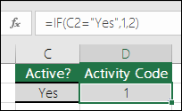
Perform conditional operations by using functions
A. Perform logical operations by using the IF function
F function
The IF function is one of the most popular functions in Excel, and it allows you to make logical comparisons between a value and what you expect.
So an IF statement can have two results. The first result is if your comparison is True, the second if your comparison is False.
For example, =IF(C2=”Yes”,1,2) says IF(C2 = Yes, then return a 1, otherwise return a 2).

Slide 10
Perform conditional operations by using functions
B. Perform logical operations by using the SUMIF function
SUMIF function: is use to sum the values in a range that meet criteria that you specify. For example, suppose that in a column that contains numbers, you want to sum only the values that are larger than 5. You can use the following formula: =SUMIF(B2:B25,">5")
Syntax
SUMIF(range, criteria, [sum_range])
The SUMIF function syntax has the following arguments:
range Required. The range of cells that you want evaluated by criteria. C
criteria Required. The criteria in the form of a number, expression, a cell reference, text, or a function that defines which cells will be added.

Slide 11
Perform conditional operations by using functions
C. Perform logical operations by using the AVERAGEIF function
AVERAGEIF function: Returns the average (arithmetic mean) of all the cells in a range that meet a given criteria.
Syntax: AVERAGEIF(range, criteria, [average_range])
The AVERAGEIF function syntax has the following arguments:
Range (Required) - One or more cells to average, including numbers or names, arrays, or references that contain numbers.
Criteria (Required) - The criteria in the form of a number, expression, cell reference, or text that defines which cells are averaged. For example, criteria can be expressed as 32, "32", ">32", "apples", or B4.
Average_range (Optional) - The actual set of cells to average. If omitted, range is used.

Slide 12
Perform conditional operations by using functions
D. Perform statistical operations by using the COUNTIF function
COUNTIF function: to count the number of cells that meet a criterion; for example, to count the number of times a particular city appears in a customer list.
In its simplest form, COUNTIF says:
=COUNTIF(Where do you want to look?, What do you want to look for?)
For example:
=COUNTIF(A2:A5,"London")
=COUNTIF(A2:A5,A4)

Slide 13
Perform conditional operations by using functions
A. Format text by using RIGHT, LEFT, and MID functions
RIGHT, RIGHTB functions
RIGHT returns the last character or characters in a text string, based on the number of characters you specify.
RIGHTB returns the last character or characters in a text string, based on the number of bytes you specify.
Syntax
RIGHT(text,[num_chars]) RIGHTB(text,[num_bytes])
The RIGHT and RIGHTB functions have the following arguments:
Text (Required): The text string containing the characters you want to extract.
Num_chars (Optional): Specifies the number of characters you want RIGHT to extract.
Num_bytes (Optional): Specifies the number of characters you want RIGHTB to extract, based on bytes.

Slide 14
Perform conditional operations by using functions
A. Format text by using RIGHT, LEFT, and MID functions
LEFT, LEFTB functions
LEFT returns the first character or characters in a text string, based on the number of characters you specify.
LEFTB returns the first character or characters in a text string, based on the number of bytes you specify.
Syntax: LEFT(text, [num_chars]) LEFTB(text, [num_bytes])
The function syntax has the following arguments:
Text (Required): The text string that contains the characters you want to extract.
Num_chars (Optional): Specifies the number of characters you want LEFT to extract.
Num_bytes (Optional): Specifies the number of characters you want LEFTB to extract, based on bytes.

Slide 15
Perform conditional operations by using functions
A. Format text by using RIGHT, LEFT, and MID functions
MID, MIDB functions
MID returns a specific number of characters from a text string, starting at the position you specify, based on the number of characters you specify.
MIDB returns a specific number of characters from a text string, starting at the position you specify, based on the number of bytes you specify.
Syntax: MID(text, start_num, num_chars) MIDB(text, start_num, num_bytes)
The MID and MIDB function syntax has the following arguments:
Text (Required): The text string containing the characters you want to extract.
Start_num (Required): The position of the first character you want to extract in text.
Num_chars (Required for MID): Specifies the number of characters you want MID to return from text.
Num_bytes (Required for MIDB): Specifies the number of characters you want MIDB to return from text, in bytes.

Slide 16
Perform conditional operations by using functions
B. Format text by using UPPER, LOWER, and PROPER functions
LOWER function: Converts all uppercase letters in a text string to lowercase.
Syntax: LOWER(text)
The LOWER function syntax has the following arguments:
Text (Required): The text you want to convert to lowercase.
UPPER function: Converts text to uppercase.
UPPER(text)
The UPPER function syntax has the following arguments:
Text (Required): The text you want converted to uppercase.
PROPER function: Capitalizes the first letter in a text string and any other letters in text that follow any character other than a letter. Converts all other letters to lowercase letters.

Slide 17
Perform conditional operations by using functions
B. Format text by using UPPER, LOWER, and PROPER functions
PROPER function: Capitalizes the first letter in a text string and any other letters in text that follow any character other than a letter. Converts all other letters to lowercase letters.
PROPER(text)
The PROPER function syntax has the following arguments:
Text (Required): Text enclosed in quotation marks, a formula that returns text, or a reference to a cell containing the text you want to partially capitalize.

Slide 18
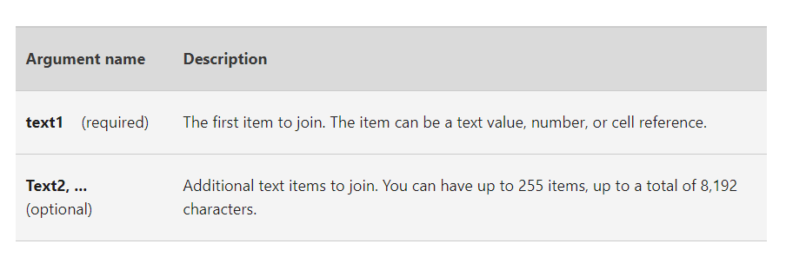
Perform conditional operations by using functions
C. Format text by using the CONCATENATE function
CONCATENATE function: Use CONCATENATE, one of the text functions, to join two or more text strings into one string.
Syntax: CONCATENATE(text1, [text2], ...)
For example:
=CONCATENATE("Stream population for ", A2, " ", A3, " is ", A4, "/mile.")
=CONCATENATE(B2, " ",C2)

Slide 19
Create charts and objects
A. Create charts
Step 1: Select data for the chart.
Step 2: Select Insert > Recommended Charts.
Step 3: Select a chart on the Recommended Charts tab, to preview the chart.
Step 4: Select a chart.
Step 5: Select OK.
Add a trendline
Step 1: Select a chart.
Step 2: Select Design > Add Chart Element.
Step 3: Select Trendline and then select the type of trendline you want, such as Linear, Exponential, Linear Forecast, or Moving Average.

